Slide 1
Data Analysis
These were my hypotheses:
- Infants are expected to demonstrate varying exploration patterns in response to changes in task difficulty. As the task complexity increases, they may extend their exploration periods, fixate on images more frequently, and exhibit heightened image-switching behaviour.
- As children gain experience with the task, they may become more efficient in their information-seeking strategies, which may lead to fewer mistakes.
- Following successful trials, infants may shorten their exploration durations. Conversely, in response to errors, they may exhibit prolonged gaze durations on the images, suggesting increased deliberation and engagement with the task stimuli.
- After experiencing errors, they may demonstrate heightened eye-switching behaviour as they attempt to optimize their performance. These adjustments in exploration and decision-making strategies may reflect young children’s emerging abilities to learn from past experiences and adapt their behaviour accordingly.

Slide 2
Four notebooks:
- Filtering_data: you will find the original dataset “data_thesis” and how I filtered out the sessions.
- Excluded of timed-out trials. They didn‘t really have an impact, did not contribute much to the analysis.
- Filtered out sessions that didn‘t go beyond the Easy level (when analyzing difficulty level).
- Filtered out sessions that completed 10 or less trials.
- Created a series of datasets to organize data by session, trialno, difficulty level, prior accuracy.
- Note: LookDur variables include duration of fixations + saccades
- Difficulty &Accuracy_Analysis: It focuses on these two features
- Previous_Trials_Analysis: It focuses on prior_accuracy
- Temporal_analysis: focuses on babies’ progression over time.

Slide 3
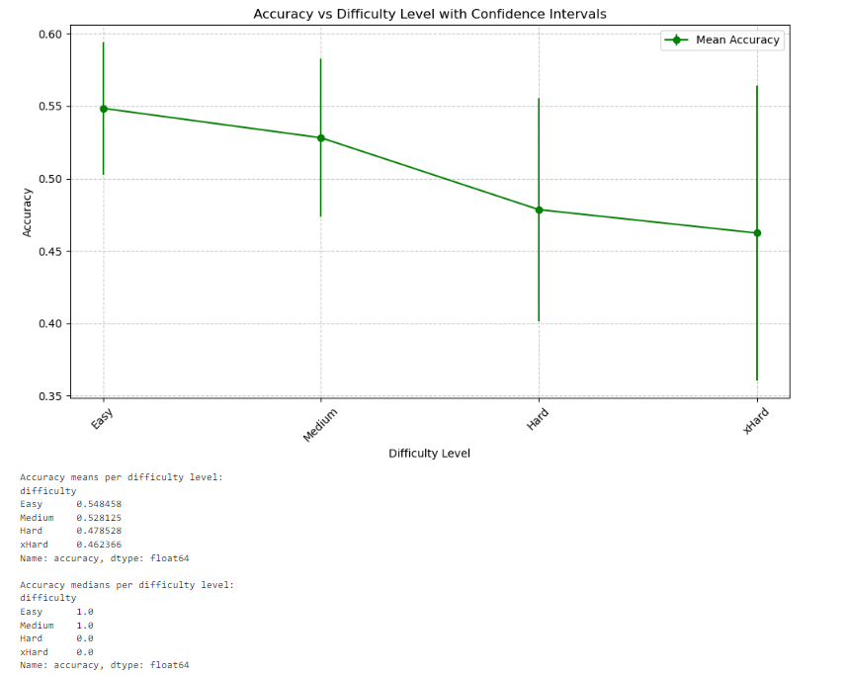
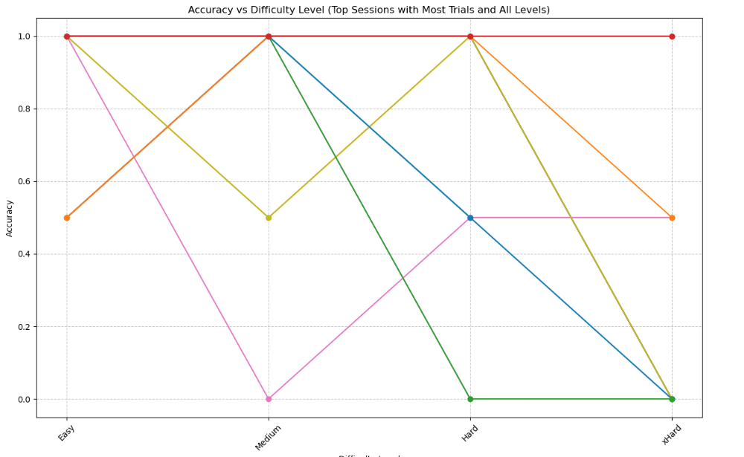
Accuracy vs. Difficulty level

Slide 4
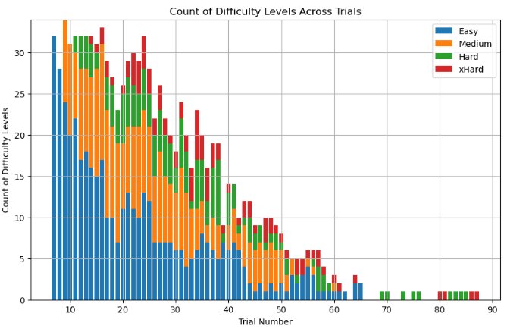
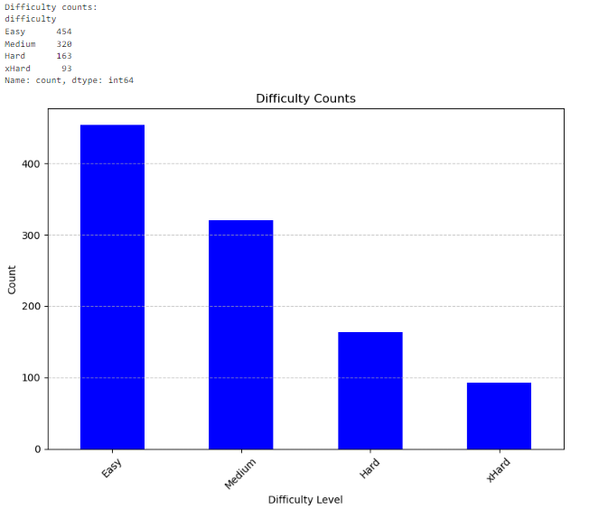
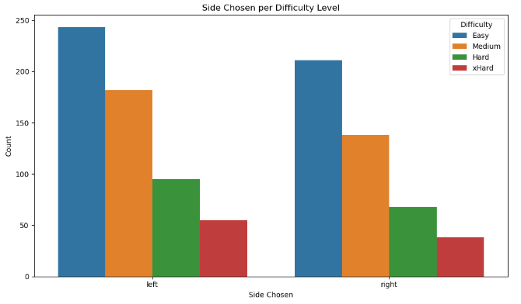
Difficulty Analysis

Slide 5
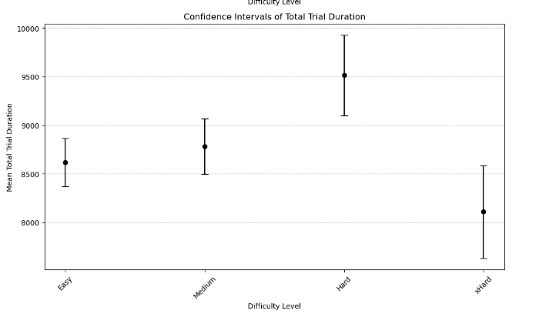
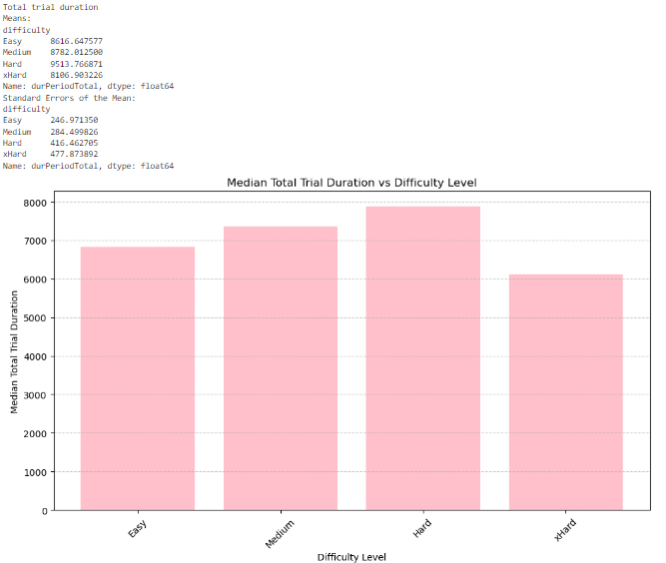
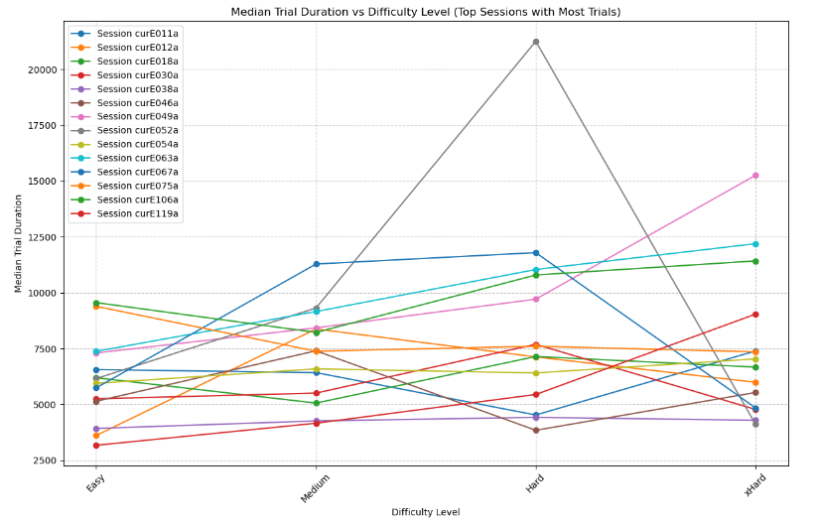
Difficulty Analysis

Slide 6
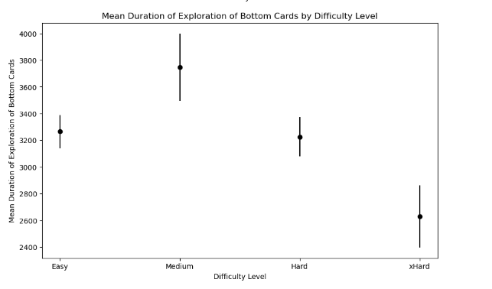
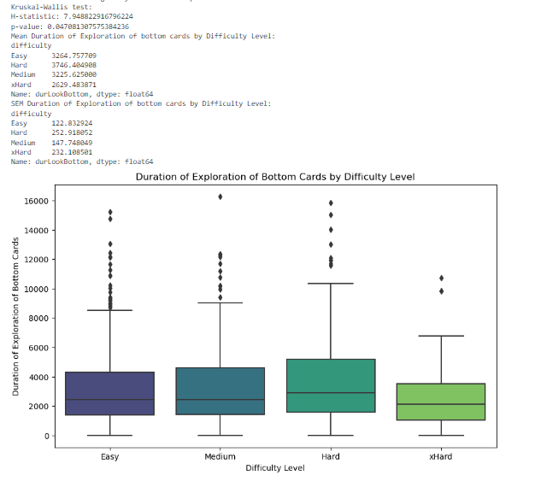
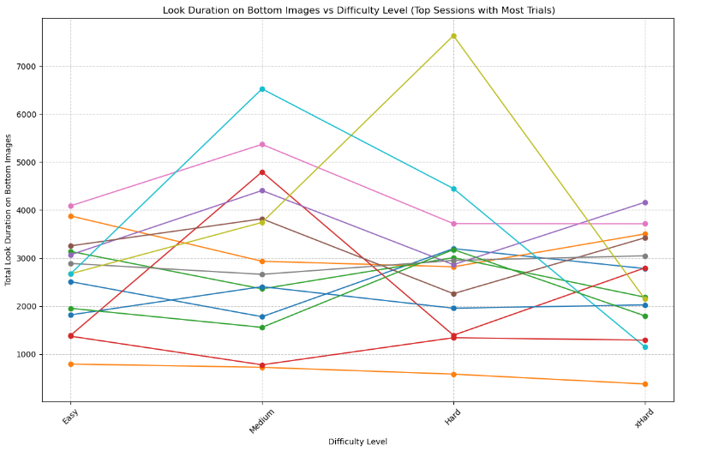
Difficulty Analysis

Slide 7
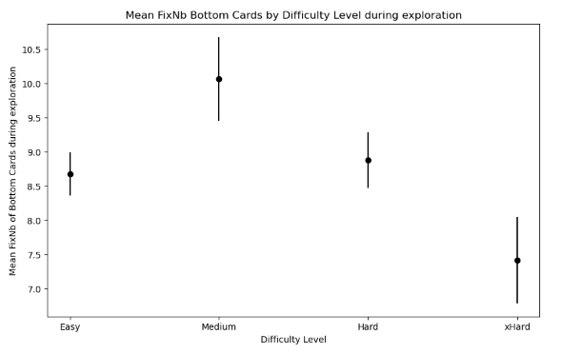
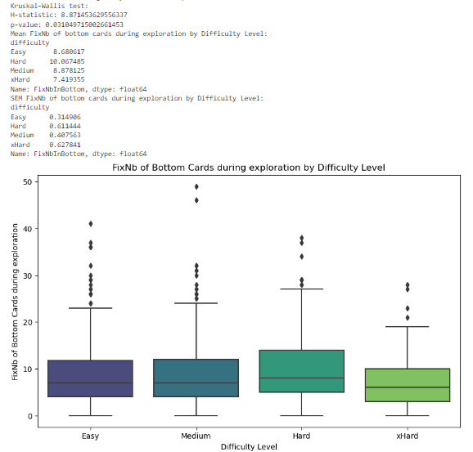
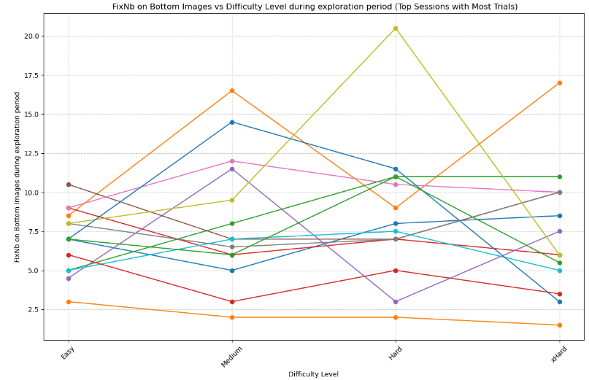
Difficulty Analysis

Slide 8
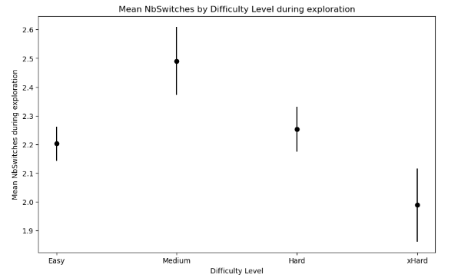
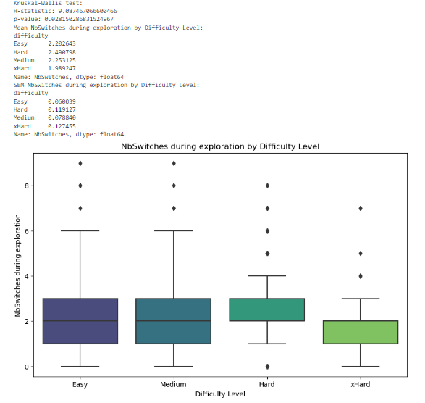
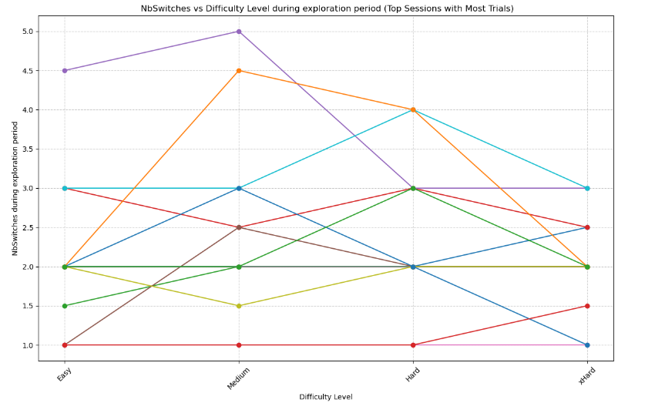
Difficulty Analysis

Slide 9
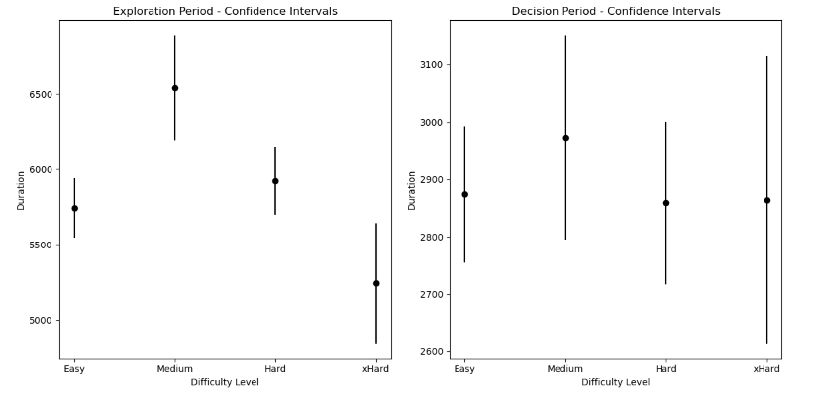
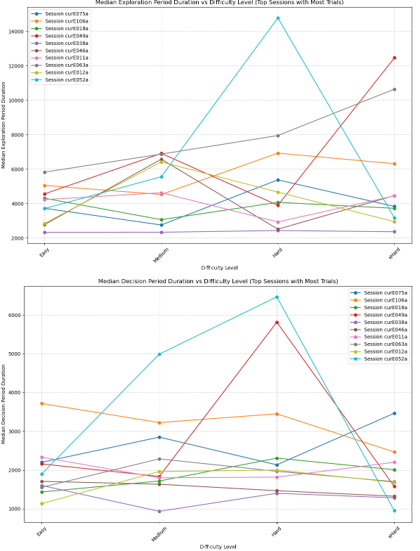
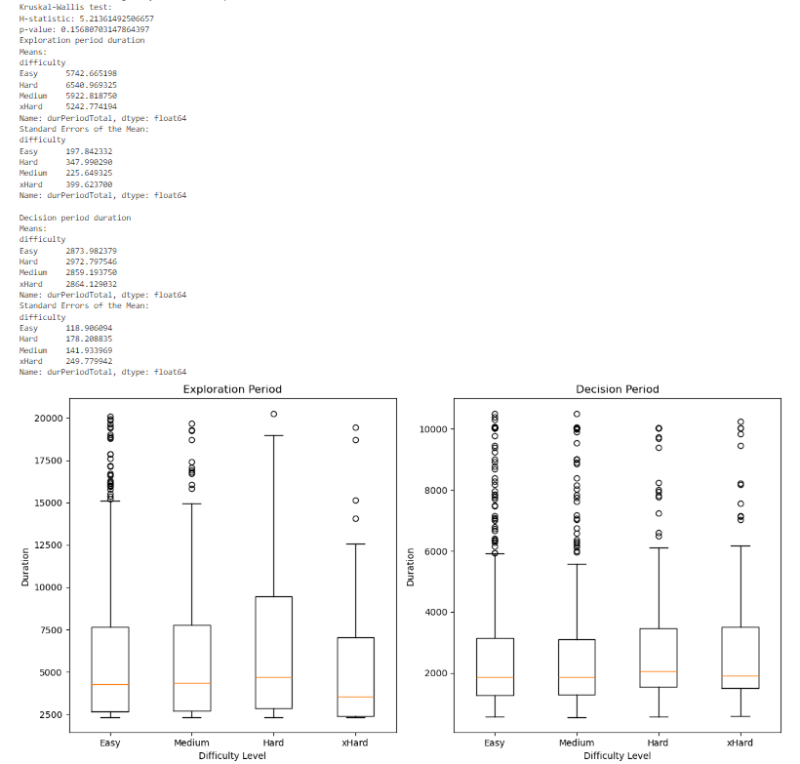
Difficulty Analysis

Slide 10
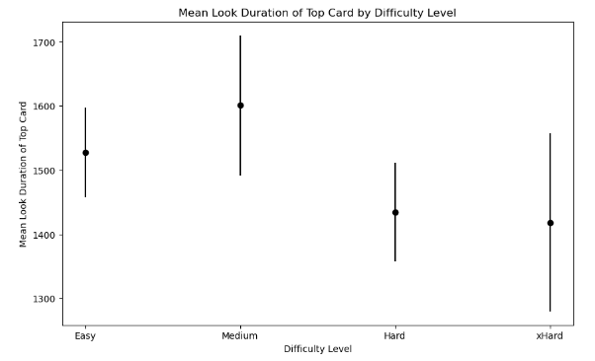

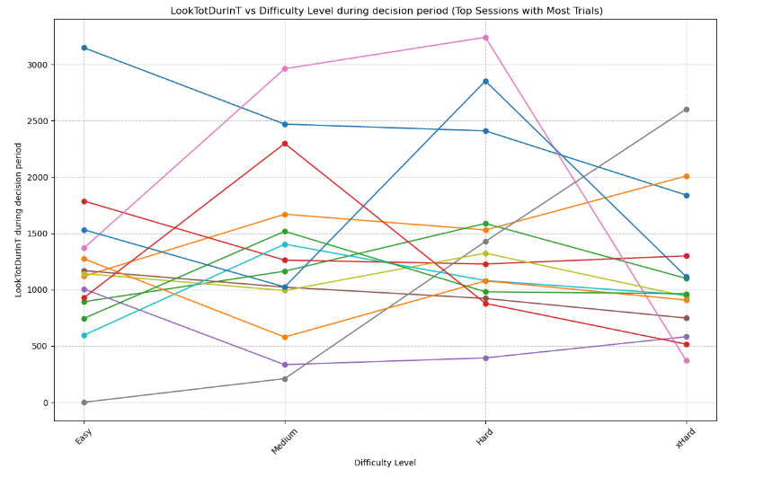
Difficulty Analysis

Slide 11
Difficulty analysis
I first tried running a simple mixed effects model on different combinations of features taking all of the sessions into account. When I saw I was getting bad results, I thought that maybe if I clustered babies first according to their information-seeking strategies, based on difficulty level, I could get better results. This was not the case:
- I pivoted the dataset to include a column per difficulty level per variable (for example: durExplorationPeriod_Easy, durExplorationPeriod_Medium and durExplorationPeriod_Hard).
- Note: I excluded xHard trials from this analysis. If I included this level, I would have had to drop out more sessions– because for clustering sessions according to difficulty level, I could only take into account those that had completed the four levels – only 16. Since there was so much variability for this level (probably because of the small number of trials, I thought it was best to exclude it in this case.
- To cluster sessions I tried a few approaches. In the end, I decided to analyze how each variable changes for the three levels per session (so, to group each variable for the analysis), instead of taking each variable for each level separately. I tried clustering the sessions by taking into account different combinations of features, but there was so much variability, that I could not find better results unfortunately. The final analysis provided two (not so clear) clusters.
- I then run a mixed effects hierarchical model and a simple Bayesian hierarchical regression model for each of the clusters to see if durExplorationPeriod, durDecisionPeriod, SwitchesExplorationPeriod, FixNb, LookDurInTDecision, LookDurBottomExploration predicted difficulty. Again, I tried combining the features in different ways and, for the Bayesian model, I tried different ways of tuning and sampling it, but did not have better results than the ones I already got. You can find the model and clustering results in the Difficulty & Accuracy notebook.

Slide 12
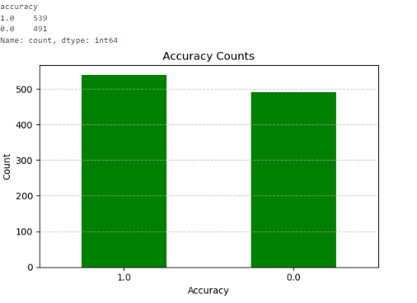
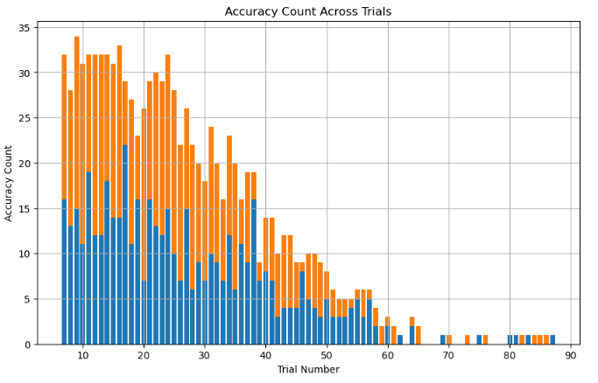
Accuracy Analysis

Slide 13
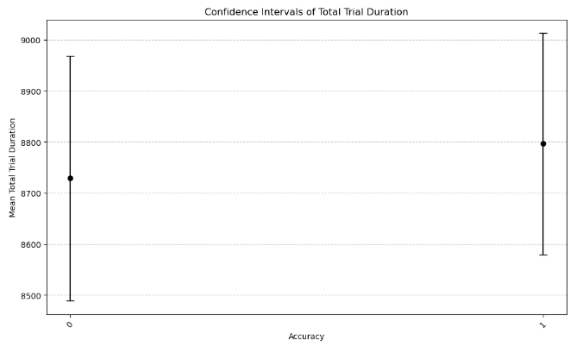
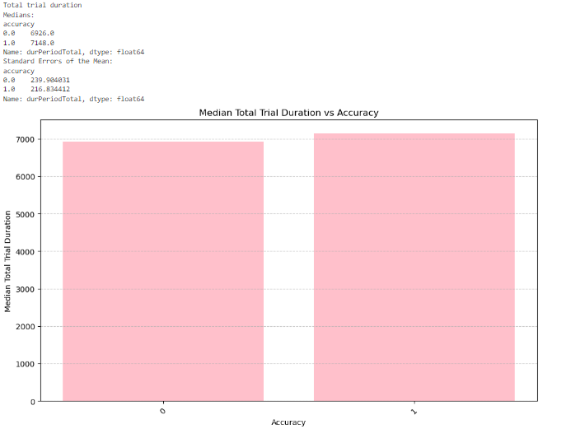
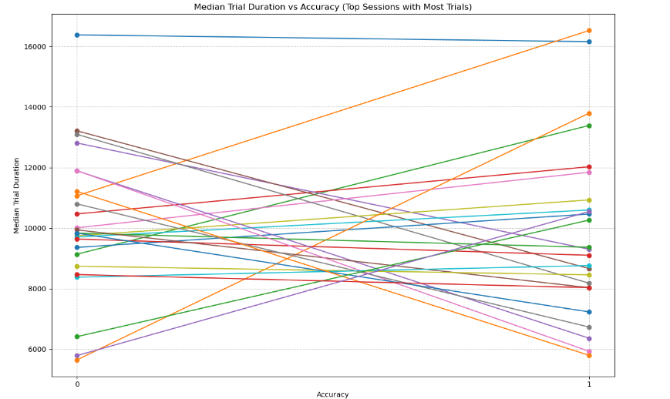
Accuracy Analysis

Slide 14
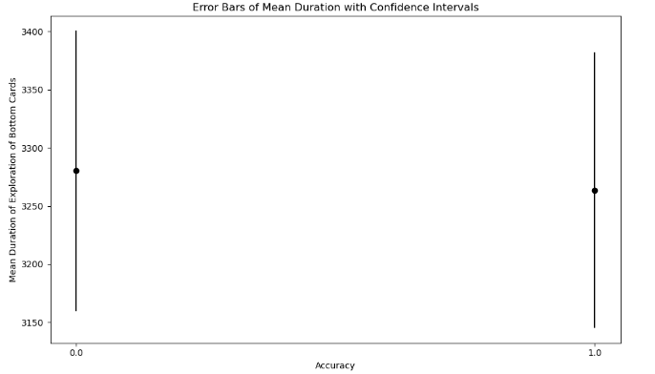
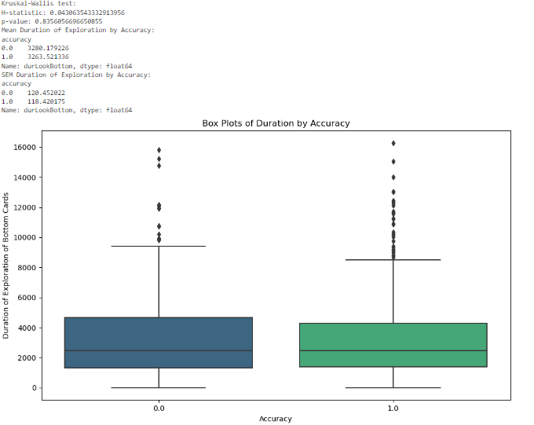
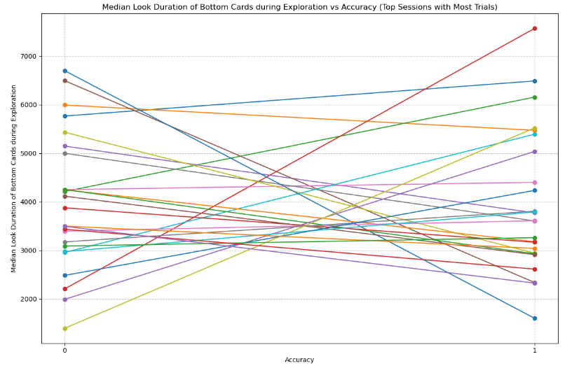
Accuracy Analysis
Look duration of bottom cards during exploration

Slide 15
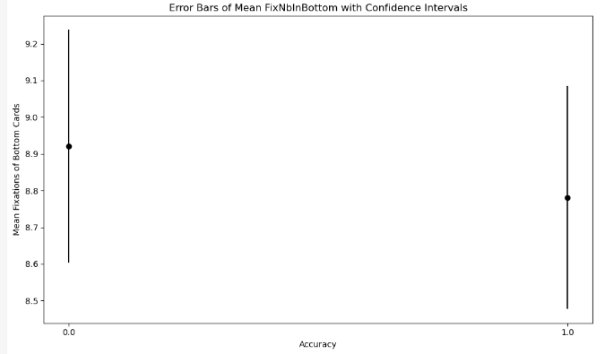
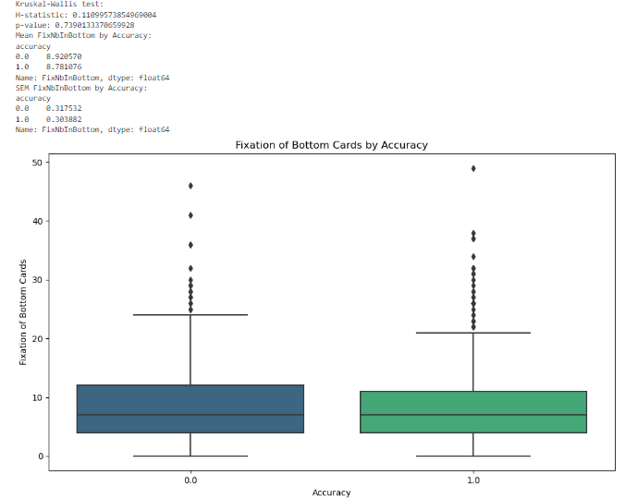
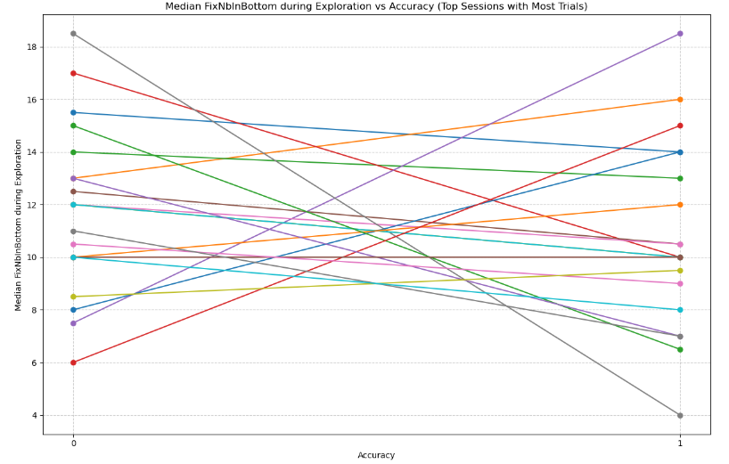
Accuracy Analysis

Slide 16
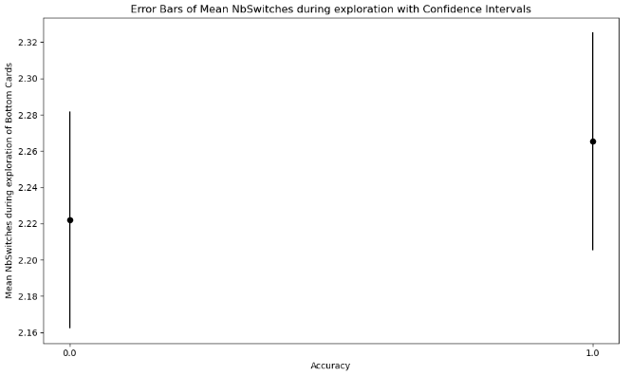
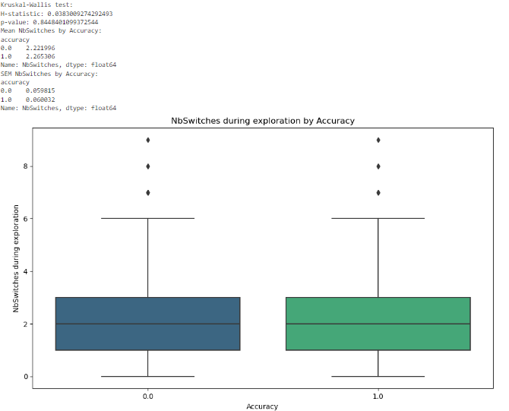
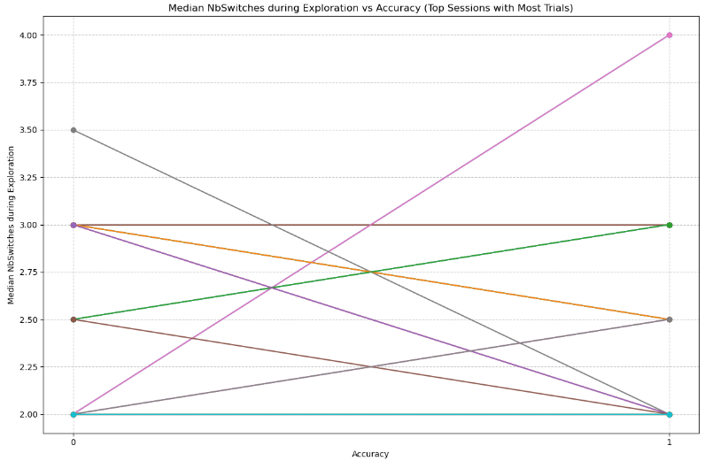
Accuracy Analysis

Slide 17
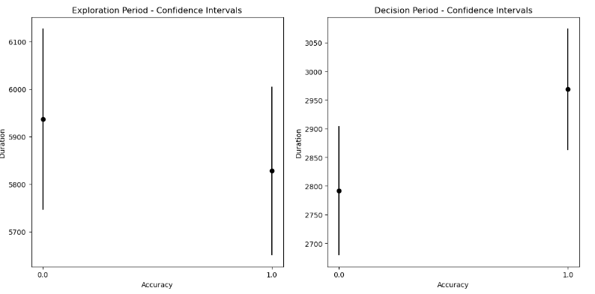
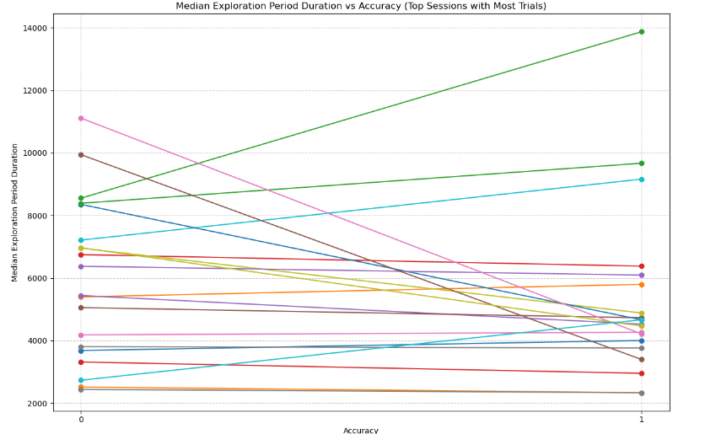
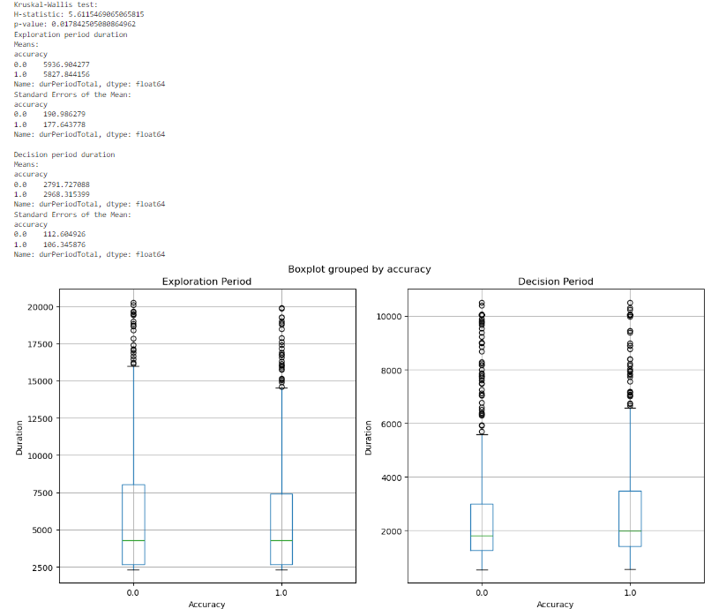
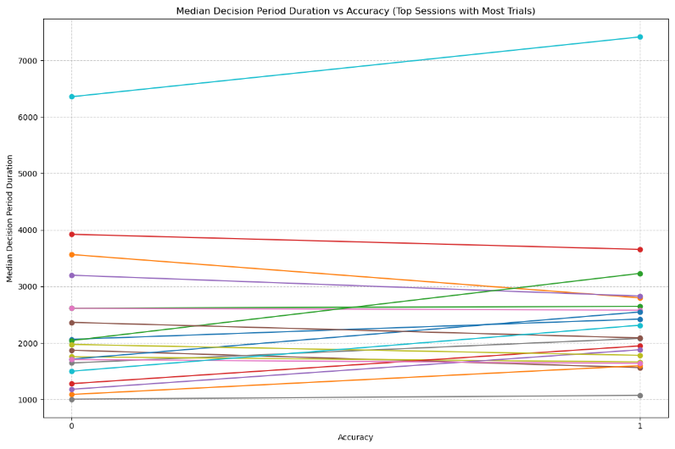
Accuracy Analysis

Slide 18
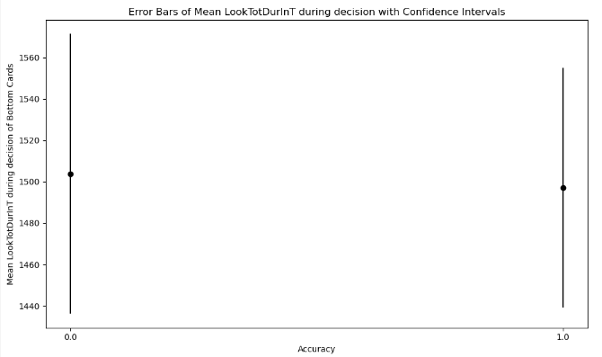
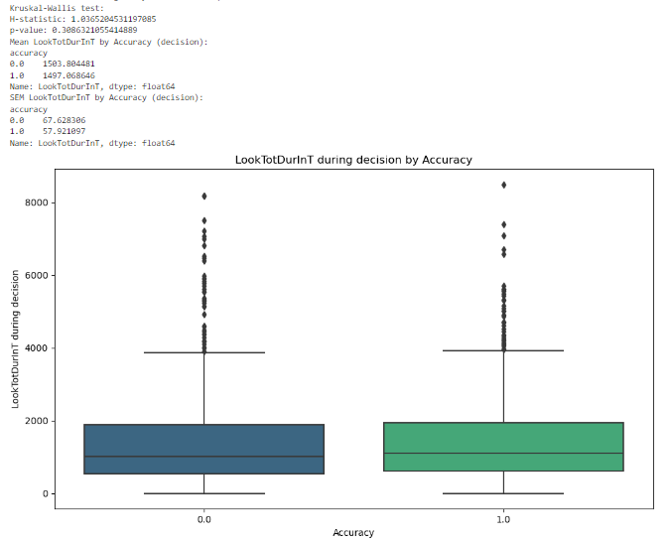
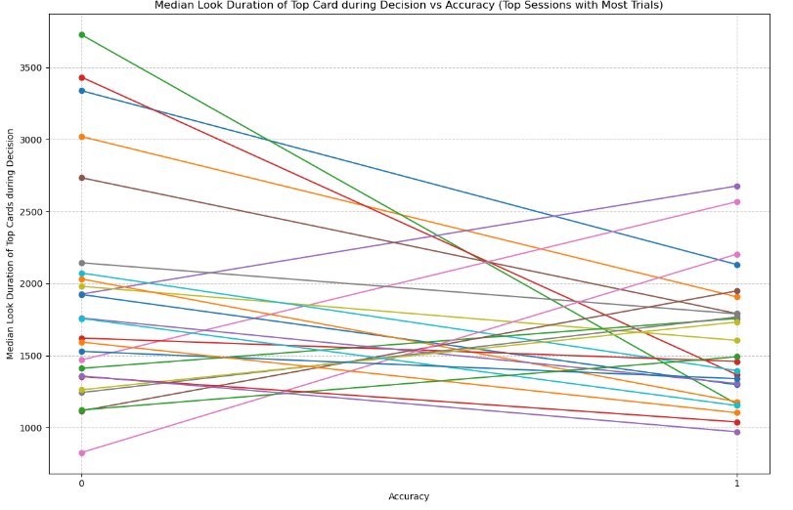
Accuracy Analysis

Slide 19
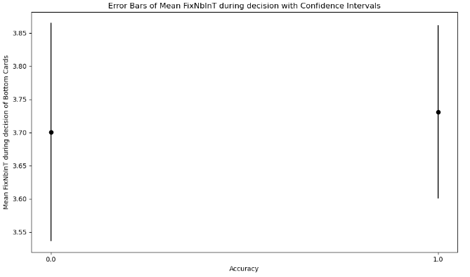
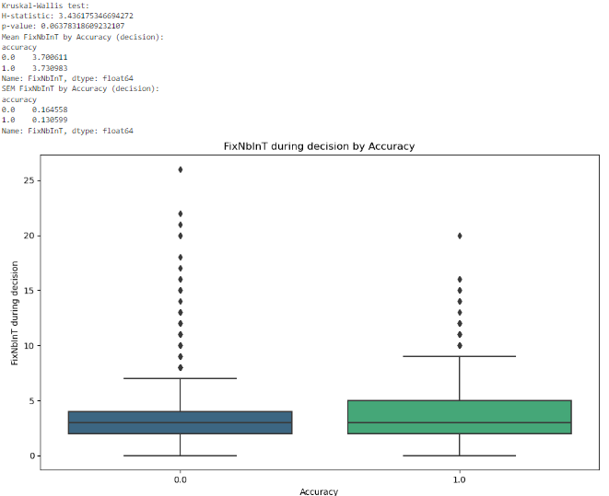
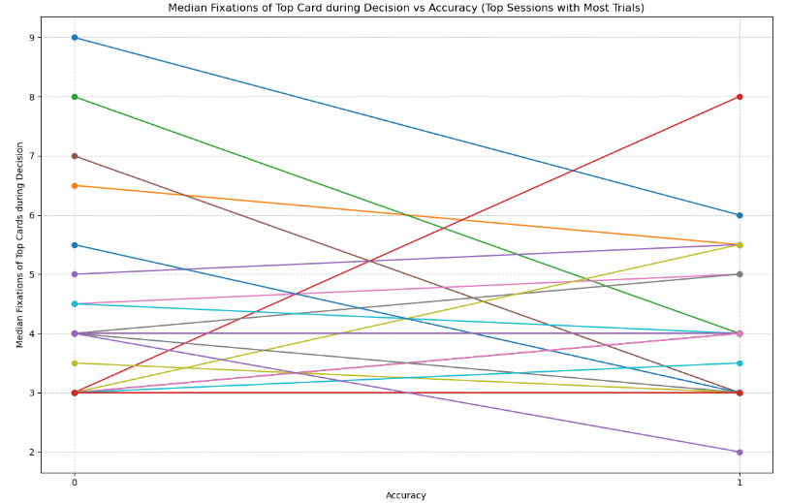
Accuracy Analysis

Slide 20
Summary Difficulty and Accuracy Analysis
In summary:
- The more complex the task, the longer the exploration (exploration period duration, duration of exploration of bottom cards, number of fixations of bottom cards – not for number of switches between the bottom cards during this period, where there is no clear pattern). This applies for Easy, Medium and Hard levels. For the xHard level, numbers usually decrease (and are lower than for the Easy level), but if we see the confidence intervals, we understand that there is variability, and we also know by looking at the data that there are not so many xHard trials to start with). For how the difficulty levels impact the decision period, there is no clear pattern.
- There are in general no huge differences between children‘s exploratory patterns and if they succeeded/ failed the task.
- In general, almost no statistically significant correlations
- Clustering babies based on how they behave for each difficulty level did not provide good results, and neither did the models I tried with different combinations of features and clusters.

Slide 21
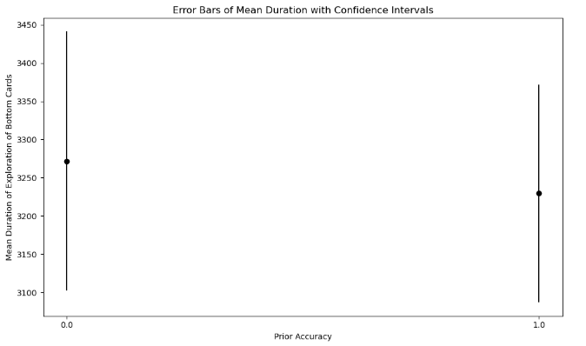
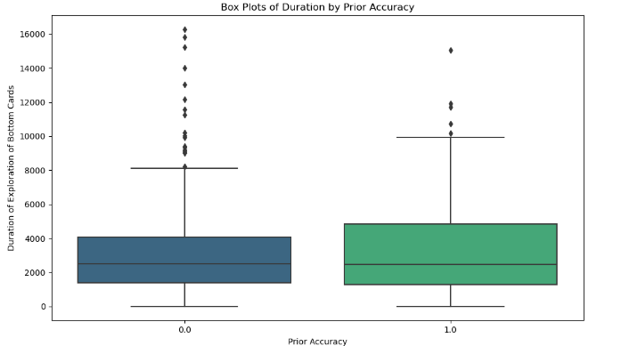
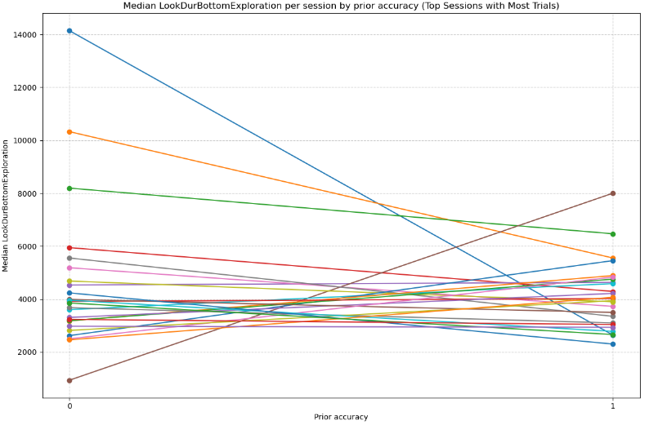
Prior Accuracy Analysis
Look duration of bottom cards during exploration

Slide 22
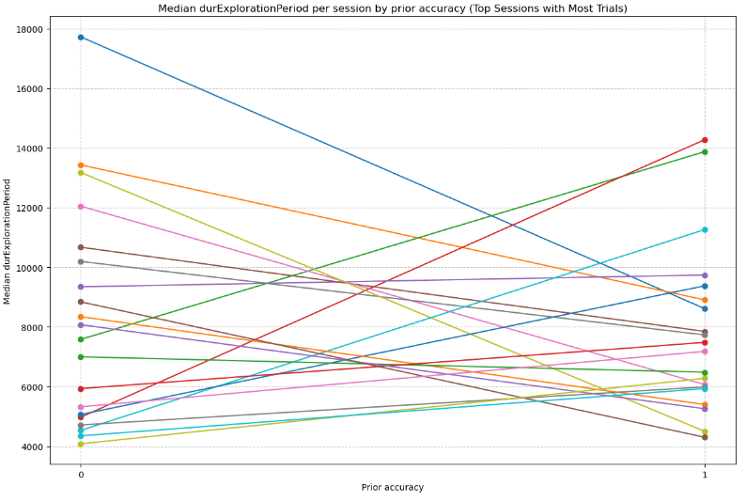



Prior Accuracy Analysis

Slide 23



Prior Accuracy Analysis

Slide 24



Prior Accuracy Analysis

Slide 25



Prior Accuracy Analysis

Slide 26


Prior Accuracy Analysis

Slide 27


Prior Accuracy Analysis

Slide 28


Prior Accuracy Analysis
I wanted to analyze each children’s improvement (trial by trial) for different variables depending on if the prior accuracy was correct or incorrect. To calculate improvement, I computed the difference among a variable during a trial and the same variable for the previous trial). There was nothing significant to report when analyzing this session by session.
I also computed the slope of Improvement for each variable depending on prior accuracy (median of all sessions), but there are no significant results here either.

Slide 29
Prior Accuracy Analysis
- Total trial duration, exploration and decision periods and fixation numbers seem to be higher if the prior accuracy was 0 (incorrect). This pattern is not followed by Number of Switches between bottom cards. No significant correlations, though.
- I wanted to cluster sessions and see if there was a general pattern of how different groups of babies behave depending on if the prior accuracy. For this, I created a dataset that contained information per session, instead of per trial and pivoted the dataset to get, a variable per prior accuracy (for example: durExplorationPeriod_0, durExplorationPeriod_1).
- There was a lot of variability and, after trying the elbow method to find out how many optimal clusters there well, not even 10 clusters were enough.
- Still, in order to see if I could predict accuracy based on different combinations of features, I tried to run a simple mixed effects model and a simple Bayesian hierarchical regression model with different combinations of variables for the two most important clusters, but nothing really worked.
- I also computed the cumulative sum of improvements by prior accuracy for different variables. Nothing really provided clear results, not even after trying to implement moving average.

Slide 30



Temporal analysis
I calculated the cumulative accuracy per session and then clustered sessions based on their tendency to improve or get worse throughout the task.
I then used the clusters presented here and checked the progression (cumulative sum of improvement) of sessions in cluster 1 (tendency to get worse in the memory task) and cluster 2 (tendency to get better in the task) for a set of variables. I did not get anything relevant of reporting.

